Slide 1
WBG’s vision and strategies to build a strong innovation ecosystem to scale up DATs
How is WBG financing the future of food,
building a Sustainable & Prosperous Africa?

Slide 2
1
Digital Moonshot for Africa
2
Digital Disruption in Agriculture
Why agriculture is important in Africa
CONTENTS
3
Digital Moonshot for Agriculture in Africa

Slide 3
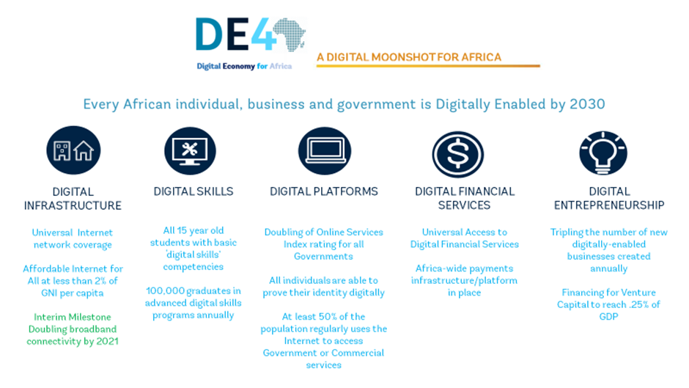
Digital
Moonshot
Notes:
Moonshot Africa is an ambitious World Bank initiative to connect individuals, firms, and governments in Africa to fast internet.

Slide 4
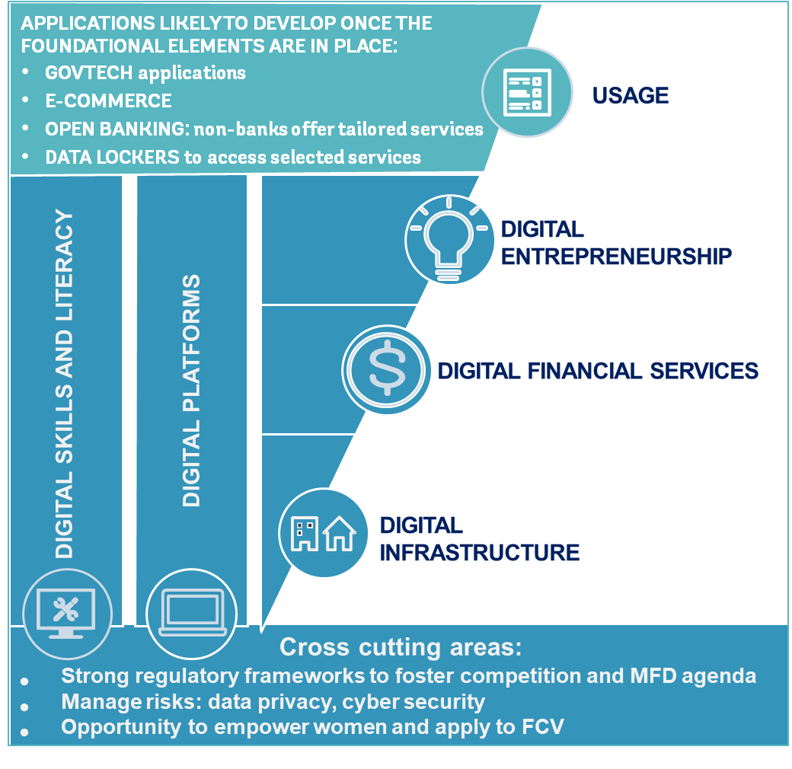
The 5 foundations
of the Digital Economy

Slide 5
“Disruptive technologies in agriculture are digital and technical innovations, which enable farmers and agribusiness entrepreneurs to leapfrog to increase their productivity, efficiency and competitiveness, facilitate access to markets, improve nutritional outcomes and enhance resilience to climate change.” These range from mobile apps to solar applications to agriculture to portable agriculture devices to biofortified foods.
2
DATs in
Agriculture

Slide 6
Potential impact of disruptive technologies in the AFS by 2030
Disrupting the Agriculture and Food System
Source: WEF 2018. Innovation with a purpose: The role of technology innovation in accelerating food systems transformation

Slide 7
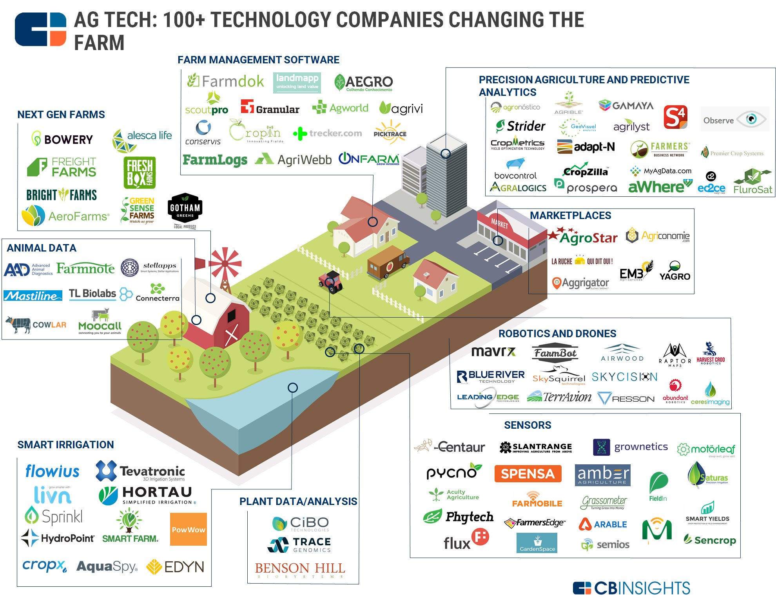

Slide 8
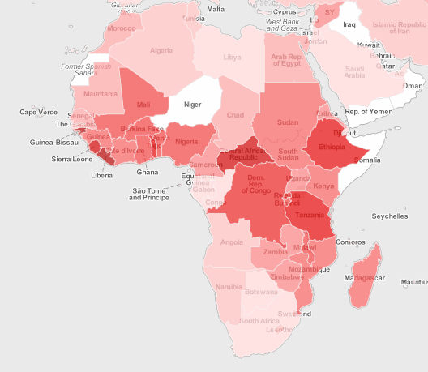
Agriculture still has huge economic importance for large parts of the population in Africa
Disrupting the Agriculture and Food System
Agriculture on average in Africa
Employs 65 percent of the labor force
Accounts for 32 percent of gross domestic product.
Without raising incomes in agriculture, prosperity cannot be widely shared
Agriculture,
value added (% of GDP)
Source: World Bank Data Group
Notes:
Much more than in any other region, agriculture is a major driver of African economies, typically representing 30- 40 % of GDP and 65-70 % of labor force. Notwithstanding the fact that Africa is the most rapidly urbanizing region, agriculture will remain the dominant sector for many years in most African countries. The very fact that agriculture is so important to the incomes of so many persons makes it the key to shared prosperity.
The reality is that Africa is the breadbasket of the world, and in eastern and sub-Saharan Africa, the way to impact the vast majority of human beings is through farming,

Slide 9
Food demand will be 155% higher in SSA
Disrupting the Agriculture and Food System (AFS)
+17%
+47%
+155%
+51%
+27%
Notes:
Annual growth in food demand is projected to be 3% per year till 2030 (UNDP). Increase is linked to population growth and urbanization

Slide 10
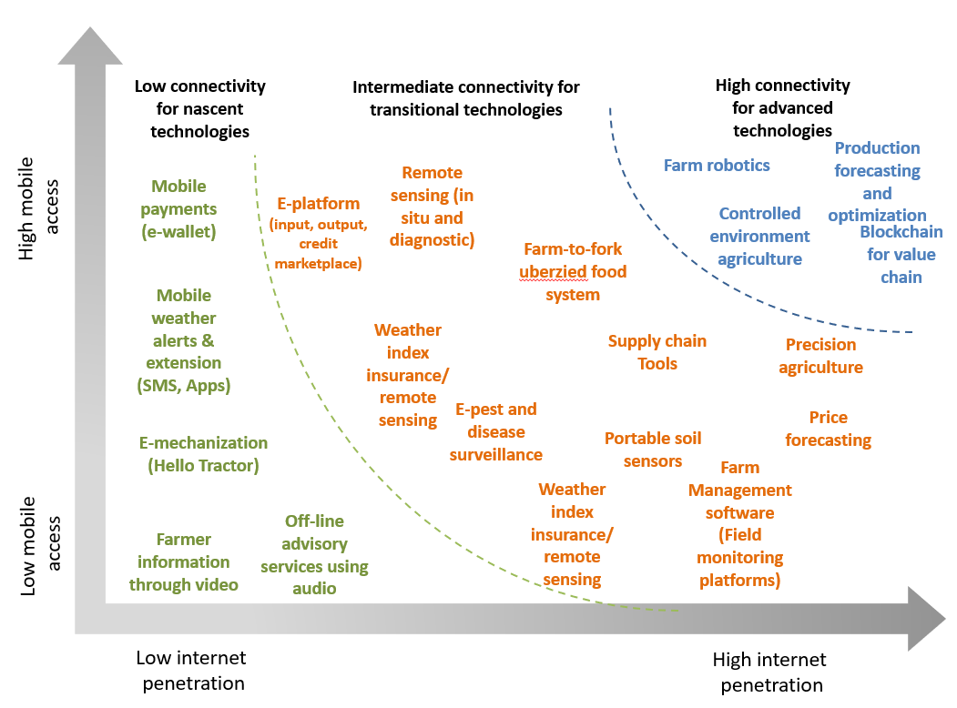
Different stages of connectivity require different types of digital technologies (nascent, transitional & advanced)

Slide 11
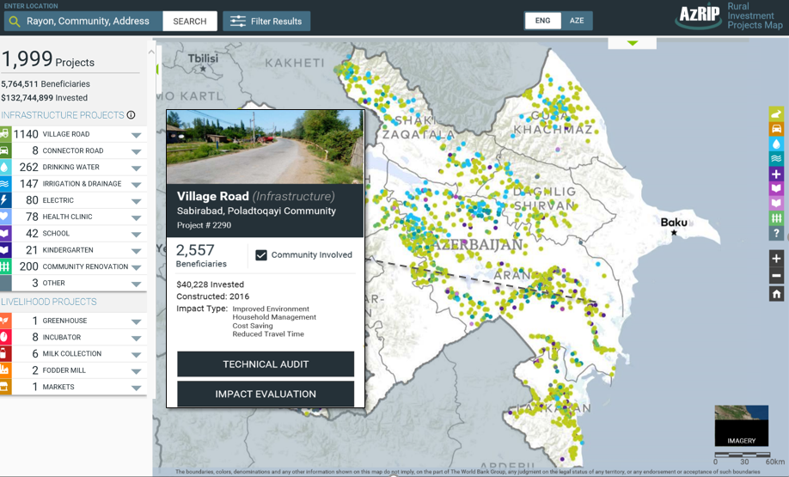
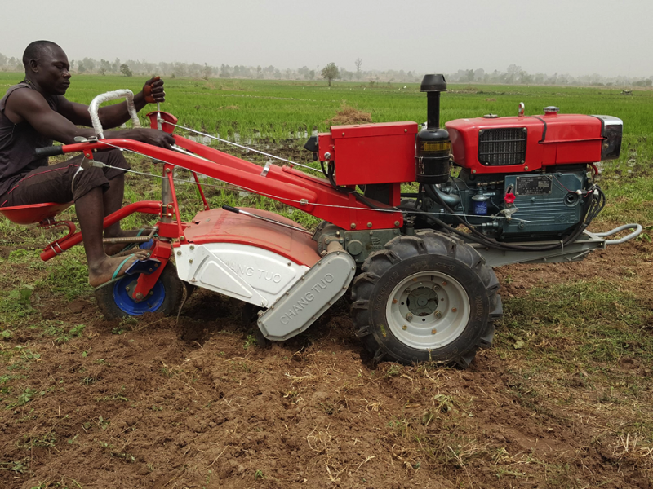
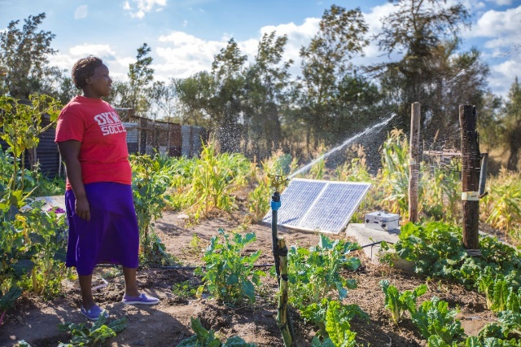
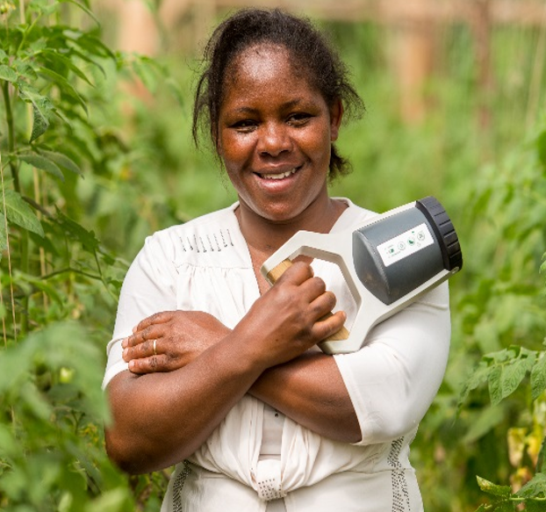
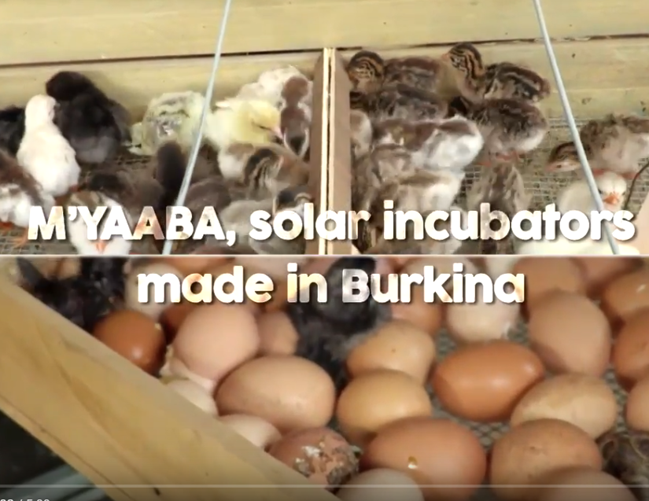
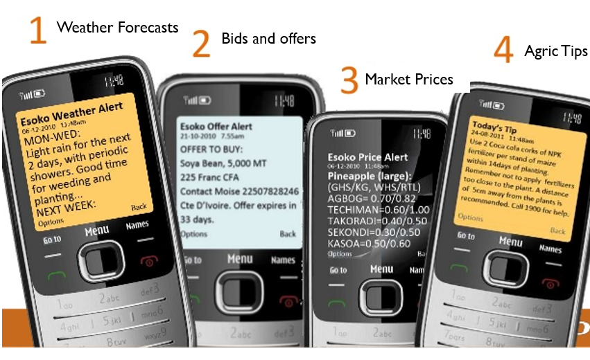
Examples of DATs in SSA
Geo-enabled M&E
Hello Tractor
Portable soil tester
Uganda ICT4Ag e-extension
Digital extension services

Slide 12
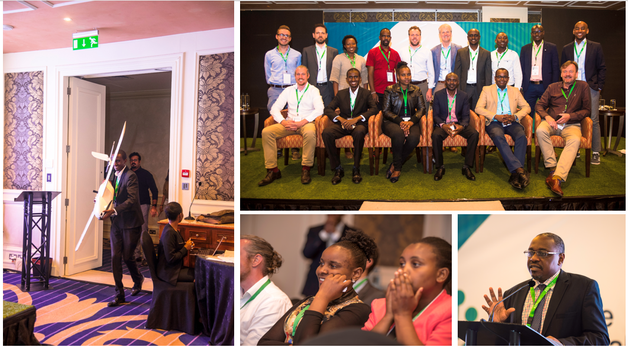
Scaling up
DATs
Notes:
Moonshot Africa is an ambitious World Bank initiative to connect individuals, firms, and governments in Africa to fast internet.

Slide 13
Disruptive Agricultural Technologies (DATS) is an emerging sector The universe is 430 – scalable is 194
Notes:
This is the data for Scalable DATs
These are preliminary findings from the stocktaking activity
For this chart, N=165
*2018 data not complete
Notes:
Add the footnote – scalable DATs – subset of the universe // sector as a whole is growing
the number of DATs founded in SSA has been increasing rapidly over the past decade.
Based on the analysis of the DAT stocktaking database, disruptive agri-tech is an emerging sector, with over 70 per cent of the DATs having been founded in the last decade

Slide 14
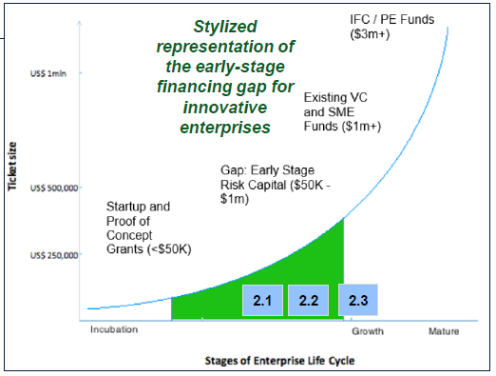
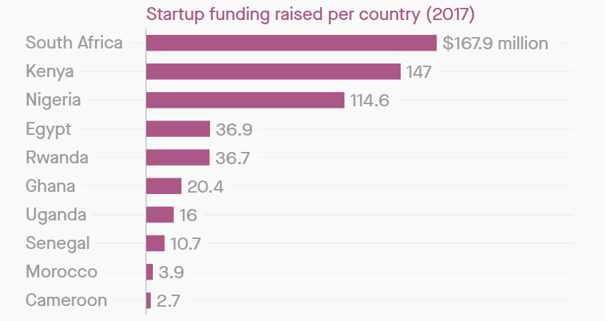
ANNEX
Accelerate Digital Innovation for Agricultural Transformation
Acceleration fund needs
Concentrated investments in few countries
Investment needs $billion
Innovation Fund
Notes:
However, most of the DAT Start-ups fail to grow. One of the key constrains to growth: growth capital.

Slide 15
Sequencing of Public actions to Facilitate Broader Adoption of Digital Technologies
E-Agriculture Strategy
Develop an e-agriculture strategy to be integrated into the overall agricultural sector development strategy
Agricultural Data Policy
Develop data policies that clarify data privacy, ownership, and sharing rules, as well as those mandating data collection and protections.
Foundation
Catalytic
Investments/ Policy
Policy and Regulatory Reforms
Public investment can be made in the areas of collecting foundational data and developing platforms
Private Sector Investment
In
Innovation Platforms
Adopt pluralistic extension and service delivery approaches to enable digital innovations and solutions to be tested and tried for smallholders.
Enable telecommunications infrastructure and payment systems in rural and remote areas to ensure good quality and predictable rural connectivity.
Invest in agricultural research, including partnerships between academic programs and industry tailored for digital agriculture technologies and innovations
Digital farmer IDs
National digital soil maps
E-government systems including smart subsidy programs
Real-time agricultural weather observatory and early warning systems (satellite, geospatial)
Digital surveillance system
Supporting
Infrastructure
Support rural broadband access and last-mile internet delivery programs.
Develop rural road networks, power, and irrigation infrastructure.

Slide 16
DAT Innovation Ecosystem Assessment Findings – Kenya vs Nigeria I
Density
30% of all DATs in SSA operate in Kenya, in a dense cluster (Nairobi)
Nigeria has fewer DATs with wider spatial distribution (Lagos, Abuja, Enugu, Ibadan, Kaduna)
Finance
Compared to global leaders, both ecosystems have received small but growing levels of funding.
Kenya ($348 million) attracted greater start-up funding than Nigeria ($306 million) in 2018
Infrastructure
Kenya has higher water and transport availability, as well as mobile and smartphone penetration.
Nigeria performs better in the number of internet users and the suitability of agricultural markets
Notes:
What does it take to create and foster conducive institutional challenges in the industry? ecosystems for scaling up disruptive agriculture technologies? How can governments and partners, such as the World Bank, help local entrepreneurs, innovators, youth, and agribusinesses to confront
Factors that limit the scale-up of DATs in Kenya and Nairobi
Silicon Savannah

Slide 17
DAT Innovation Ecosystem Assessment Findings – Kenya vs Nigeria II
Culture
Attitudes towards entrepreneurial risk are much more welcoming in Kenya; companies show greater risk-preference as well
Level of industry-university collaboration is higher in Kenya
Human Capital
Kenya has a larger and more high-quality pool of talent for DATs
Digital literacy is also higher in Kenya, driving take-up of digital technologies
Regulatory Environment
Both Kenya (126) and Nigeria (120) rank low on the ‘Ease Of Starting A Business’
Patent protection is greater in Kenya than Nigeria; data protection is weak in both
Notes:
What does it take to create and foster conducive institutional challenges in the industry? ecosystems for scaling up disruptive agriculture technologies? How can governments and partners, such as the World Bank, help local entrepreneurs, innovators, youth, and agribusinesses to confront
Factors that limit the scale-up of DATs in Kenya and Nairobi
Silicon Savannah

Slide 18
What
Helping clients build an ecosystem for innovation and policy support for disruptive agricultural technologies
How
Developing Capabilities
Fostering innovation
Broadening Access

Slide 19
Thank You

